Slide 1
NODE.JS
(The Backend Of MERN Stack)
Lecture 22

Slide 2
Today’s Agenda
What Are Static Files?
How To Serve Static Files ?
Using express.static()
Example

Slide 3
What are static files ?
Static files/resource are files whose content remains same i.e it never changes.
In short they are files of type HTML, javascript, CSS, images, and many more.

Slide 4
How to serve static files ?
It is very easy to serve static files in Express .
This is because Express provides a built-in middleware for this purpose and it is called express.static().

Slide 5
How to serve static files ?
Using express.static() method, we can serve static resources directly by specifying the folder name where we have stored our static resources.

Slide 6
Syntax
Syntax:
express.static(root, [options])
Explanation:
Here, root is the root directory from which the static assets will be served.
This is a required parameter.
The options parameter is an optional object that can be used to configure the behavior of the middleware.

Slide 7
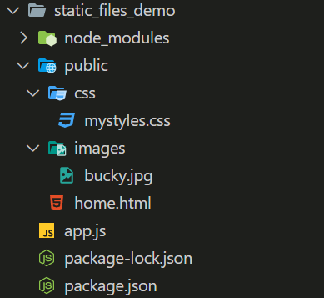
Example
Create the following folder structure:

Slide 8

The bucky.jpg file

Slide 9
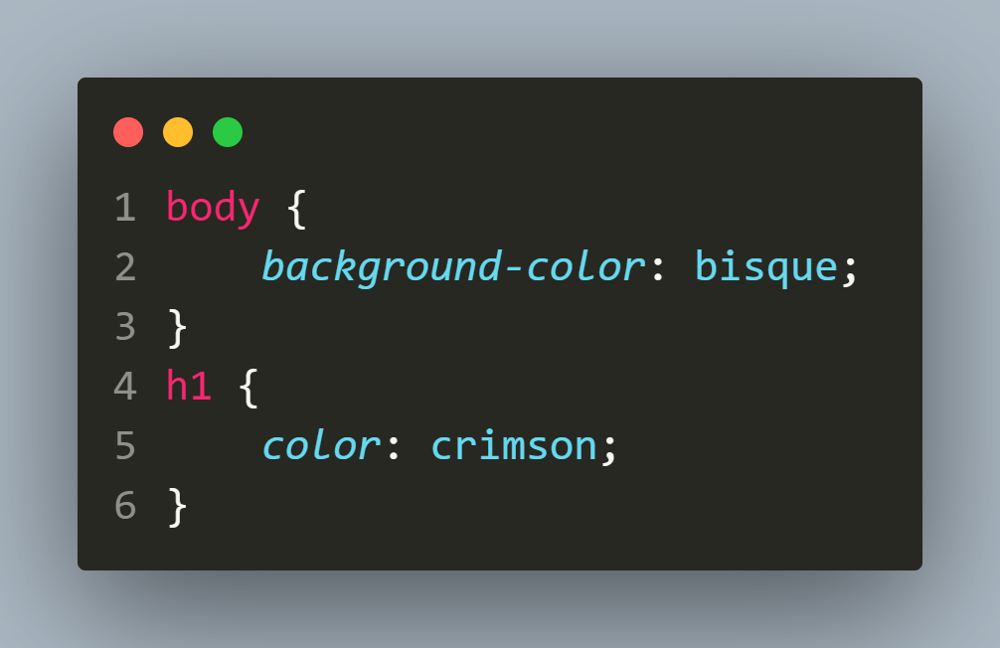
The mystyles.css file

Slide 10
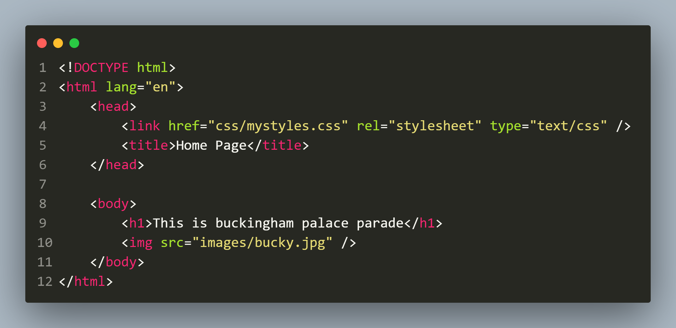
The home.html file

Slide 11
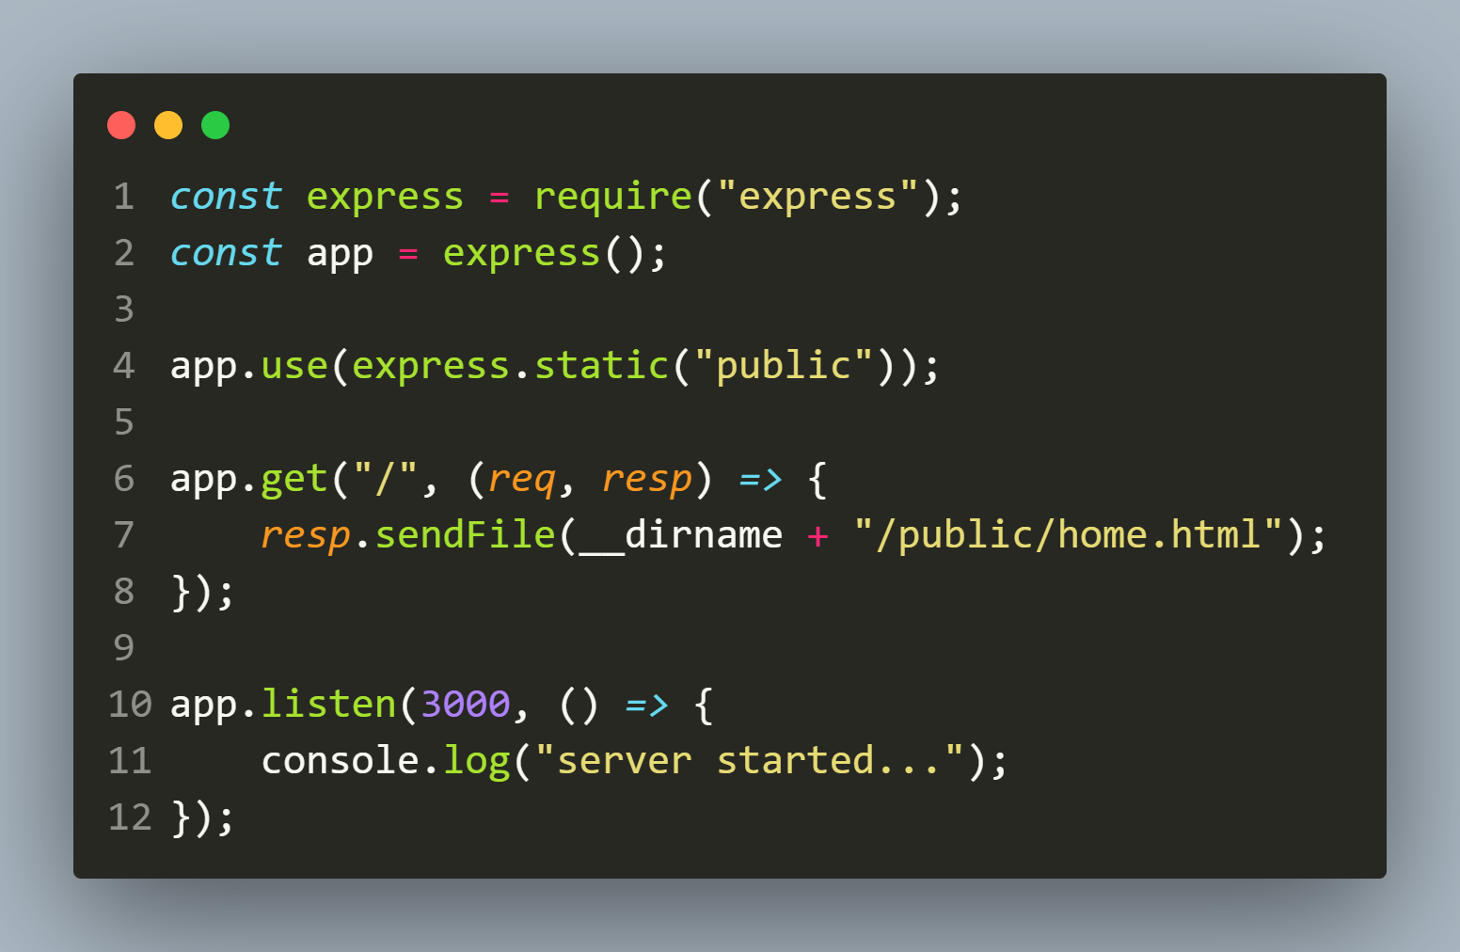
The app.js file

Slide 12
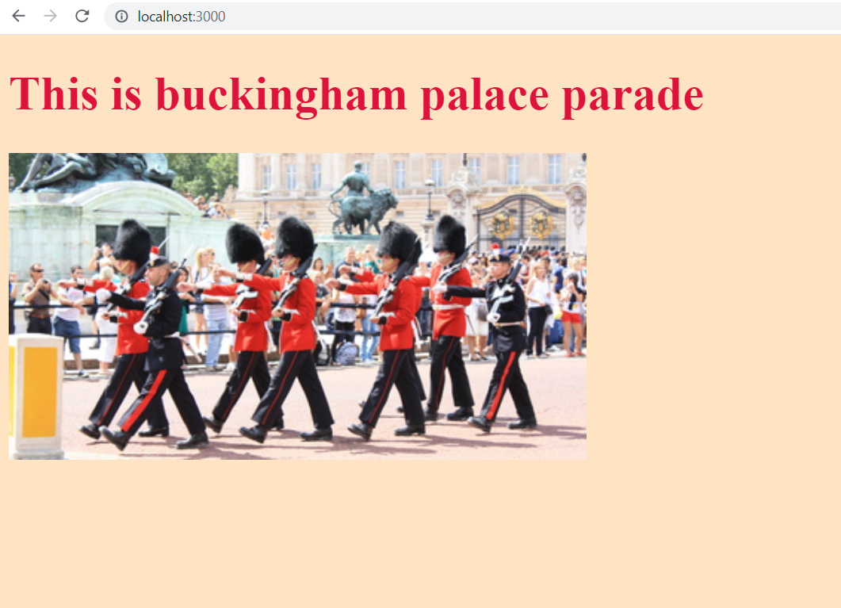
The output

